Slide 1
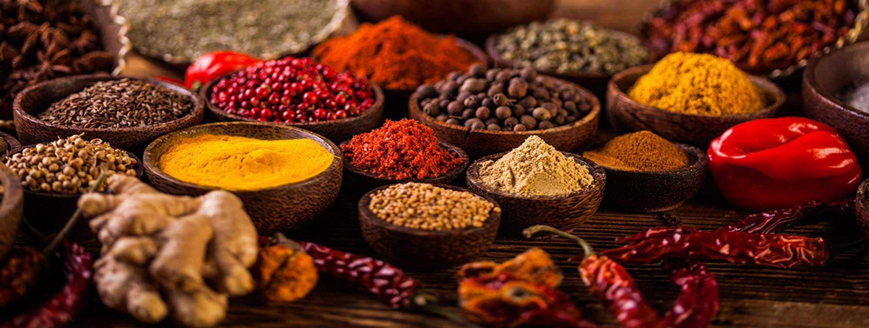
BON VIVEUR
FOOD IS HAPPINESS
Harshitha Mandru
Anuradha Vishwapriya Niradi
Sravya Bussoli
Sravya Garlapati

Slide 2
INTRODUCTION
United States of America is the second most common destination for Indians for job opportunities, higher studies and there are around 3 million Indians residing in USA as of now.
This is an attempt to make people happy who enjoy food.
We are trying to develop a website for Indians residing in few regions in the state of Texas that provides food cooked by Indian families.
This website will provide different cuisine and families can sell their authentic dish to other Indians.

Slide 3
PURPOSE
The main purpose of developing this website is Women empowerment.
Most of the Indian women who are either citizens or green card holders may not be working in companies and this website helps them in being independent financially.
We are trying to include only authentic dishes to make the website special as we have Indian restaurants and temple cafeterias in most of the places which provide normal Indian food.

Slide 4
PROJECT DESCRIPTION
Bon viveur – person who loves food.
Home food away from home.
Customers can order home food online.
The families who want to sell the food login as vendors and they sell the home made food.
The website is designed for Indian cuisine and works for Texas.

Slide 5
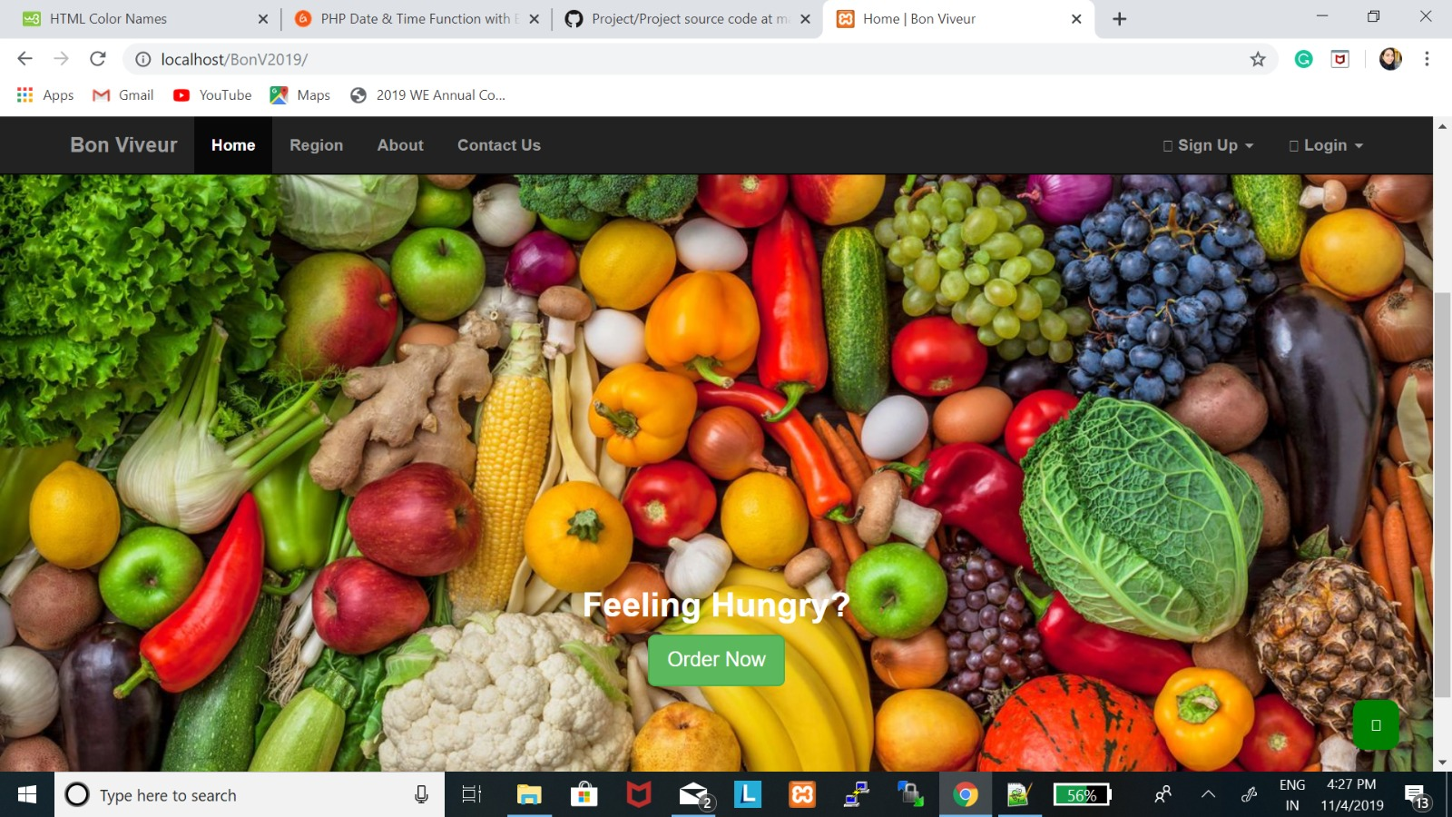

Slide 6
TEAM MEMBERS AND ROLES
Anuradha - Repository creation, documentation, database setup, customer and vendor account module code, cart and payment module code
Harshitha – Gathering requirements, presentations, customer and vendor account module code, cart and payment module code
Sravya G - Gathering requirements, registration and login module code, security features for website
Sravya B - Presentations, registration and login module code, security features for website
Initial testing, fixing errors in respective modules and final testing will be done by all the team members.

Slide 7
REQUIREMENTS
Admin has to accept orders, display vendor info., show payment details
Vendor has to register, login, update information.
Customer has to register, login and place order.
Usability, Performance, Maintainability, Availability.

Slide 8
TECHNOLOGIES USED
HTML 5
CSS
MySQL(XAMP Server)
PHP

Slide 9
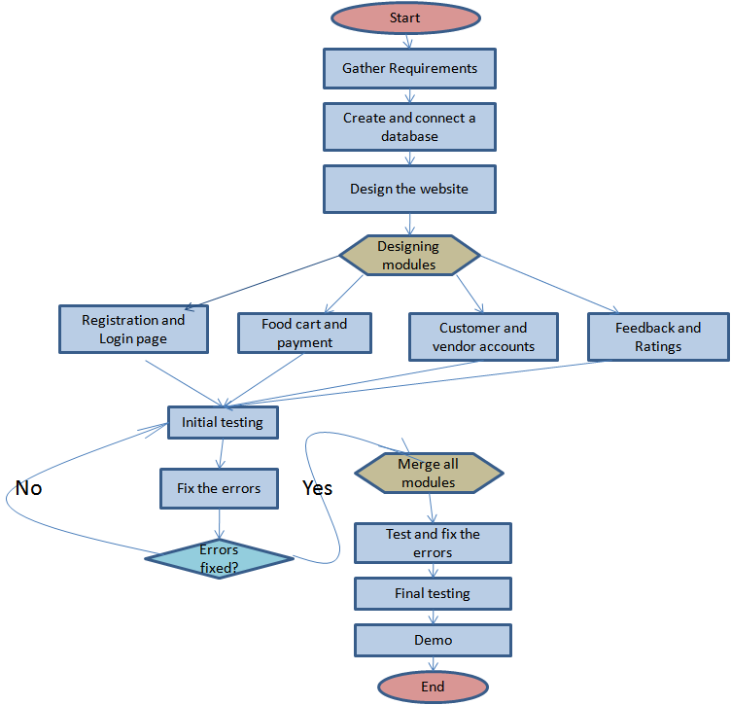
PROJECT FLOW

Slide 10
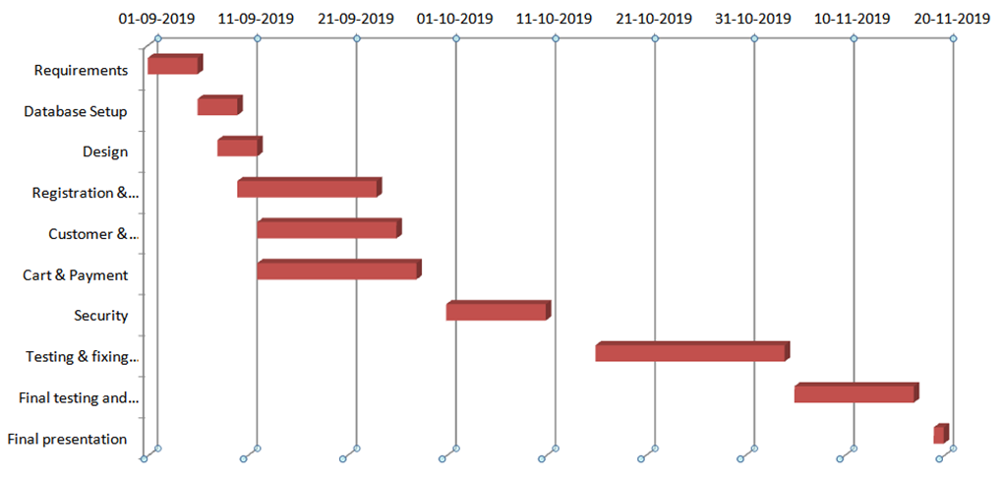
GANTT CHART

Slide 11
WEBSITE DEMO

Slide 12
TESTING

Slide 13
PEER REVIEW & CODE INSPECTION
Naming conventions-we have changed the names of the tables.
Suggested to add a column called “scope” to the users table and in the vendor table as well and can change that value for a user if that user wants to be vendor.
Advised to use SHA-256 instead of md5 to improve security.
Need to add more comments in the document to understand the code.

Slide 14
LIMITATIONS
Could not include payment gateway.
Forget password was added later but it was not done.
Email confirmation.

Slide 15
FUTURE SCOPE
Try to implement the limitations
Increase the scalability
Will implement security features

Slide 16
Thank you!

